Slide 1
17 FEB 2015
Code.org

Slide 2
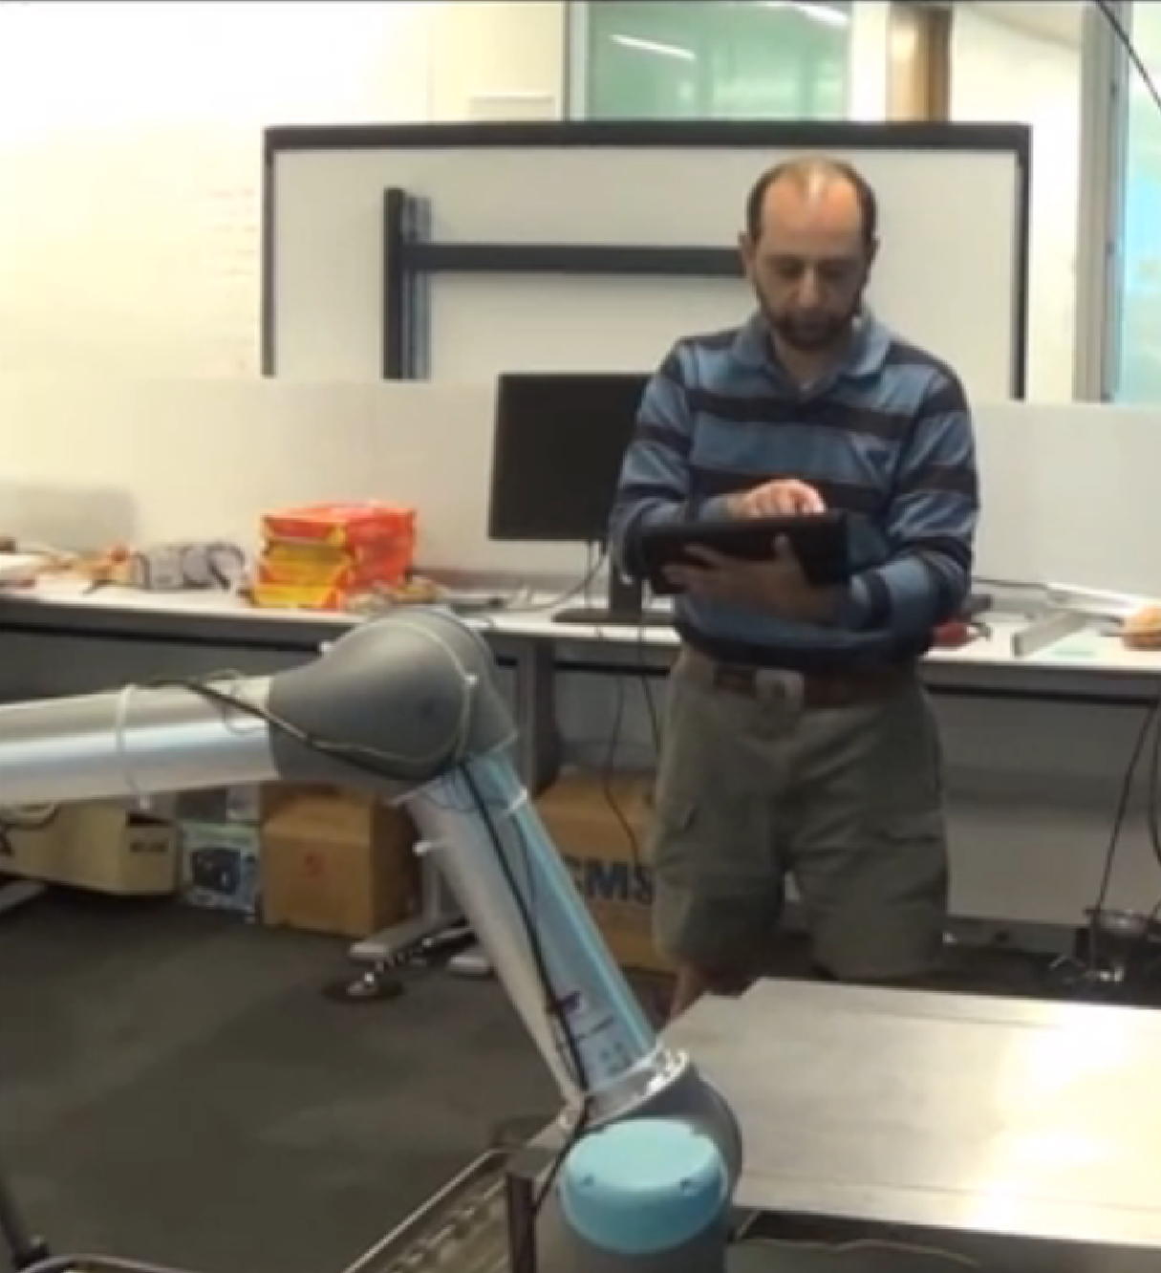
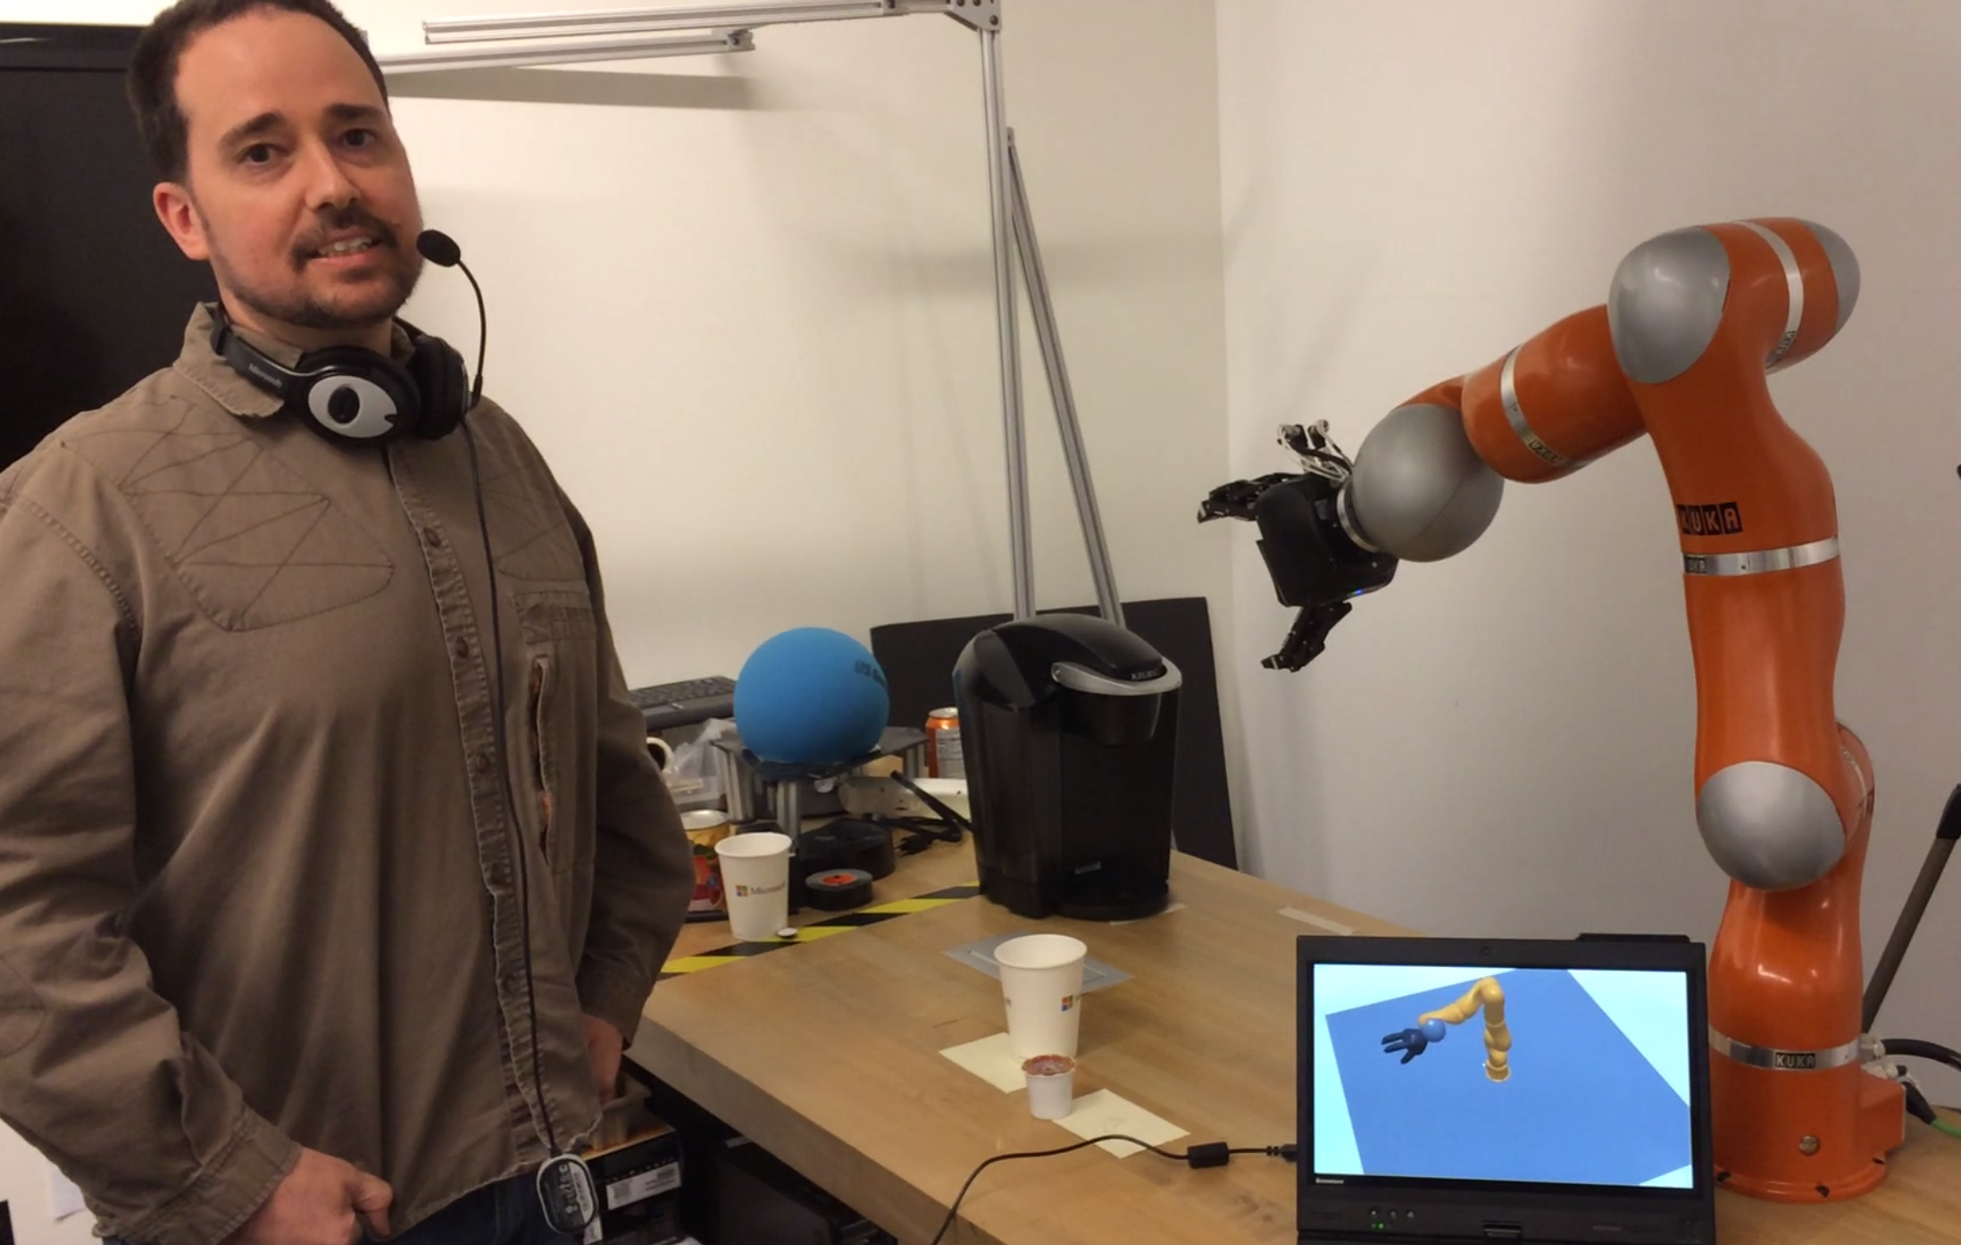
About Greg & Ashley
40+ years combined software engineering
20+ Microsoft
10+ Robotics, MSR
Breadth of work
Explored toys, hobbyist, kids programming, ...
Navigation, manipulation, research, papers, conferences, …
Self employed now...
SelfieBot, SketchBot

Slide 3
About Code.org?
Vision?
Robotics?
CS or full STEM?
Community contribution?

Slide 4
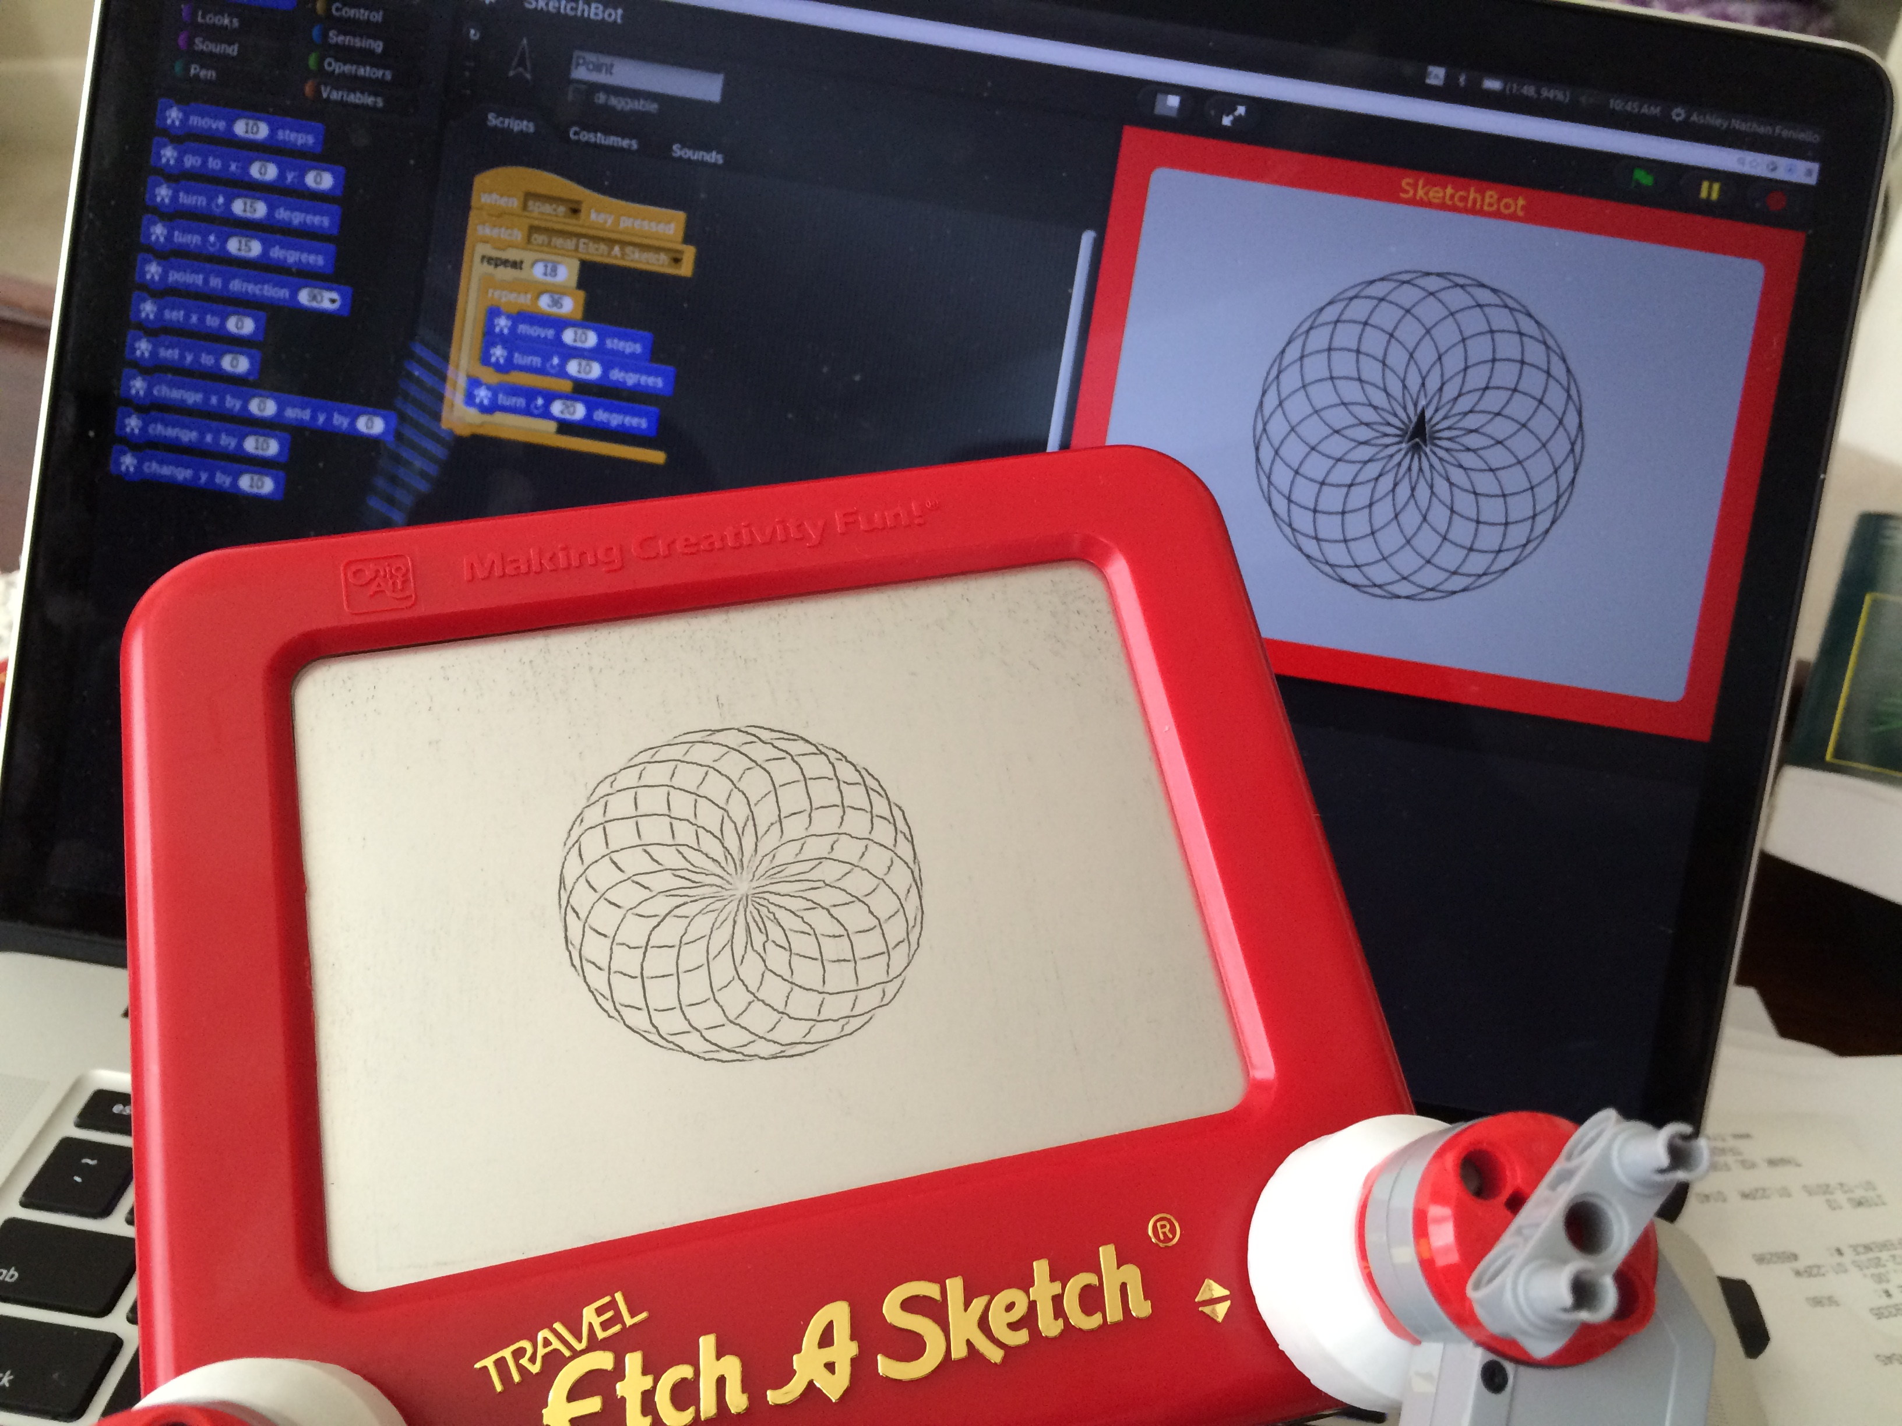
Why We're Here
We see a gap
“Robotics and science disguised as drawing”
Really control, physical system, …
SketchBot
Stumbled on this (Kickstarter?)
Could use Berkeley Snap!
Robotics in general to teach STEM
TechEd Startup Weekend (arm + curriculum)
Scribbler, Dot & Dash, ...

Slide 5
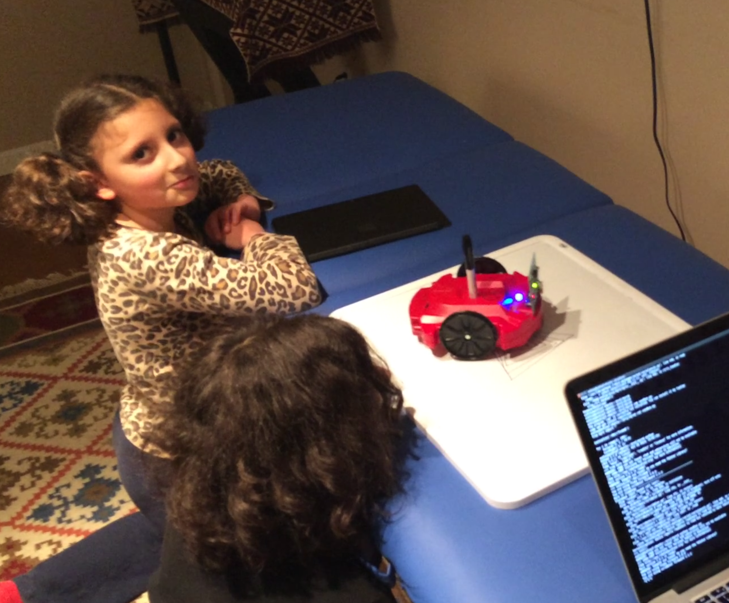
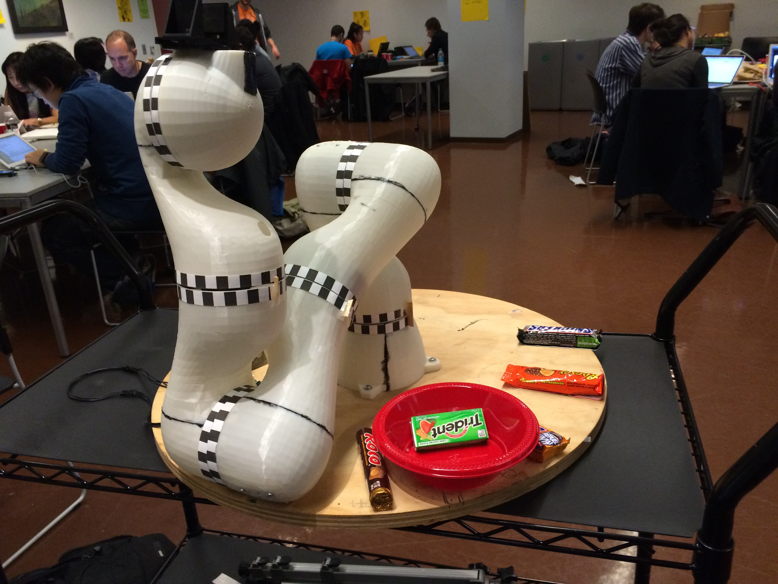
Teaching Robotics
CS
Simple: Code.org
Intermediate: Python, JavaScript, …
Serious: MIT Open Courseware, Coursera, …
Robotics
Simple: Kibo (KinderLabs) – trivial
Intermediate: Lego, Scribbler, …
Serious: Arduino, RPi, open ended (first real robotics)
We want to teach transferable skills
Imperfect sensors/actuators, physical constraints, …
Simulation, concurrency, open/closed loops,
SketchBot is 2 of 4 DOF vs. 3D printer

Slide 6
Demo
Hardware (Lego, 3D printed “hands”, …)
Berkeley Snap! Programming
Simulator
Connect real device, run proxy, calibrate, …
Sketch!

Slide 7
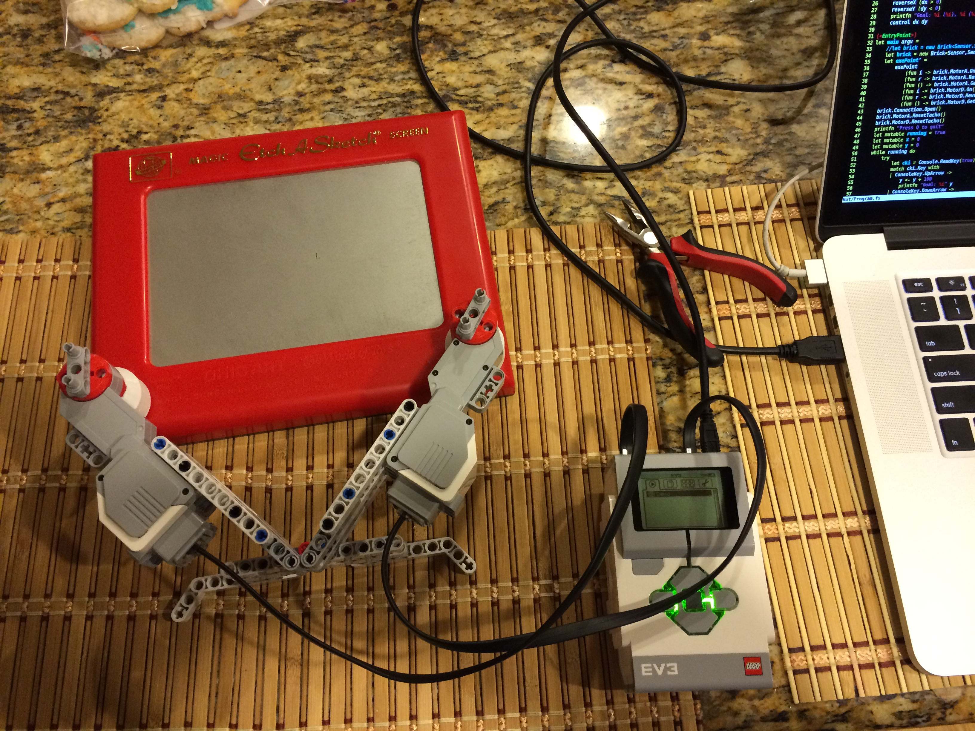
Pitch
Hook SketchBot into Code.org instead of Snap!
Open source controller (Lego NXT/EV3)
Open source 3D model
Release DIY (steppers, MCU, …) $10 BOM
Provide curriculum
Spin up:
Kickstarter ourselves?
Promoted by Code.org

Slide 13
